Slide 1
The Human
Unit 3
CC7 Human Computer Interaction
Arnemie Gayyed

Slide 2
Table of Contents
The role of humans in HCI
Human error
Human emotions

Slide 3
Role of Humans in HCI
The Human | The Perceptual System | Human Memory | Human Thinking

Slide 4
The Human
Human computer interaction starts with the human
The central character is the human
There is a need to understand:
Human capabilities
Human limitations
There is a need to use a simplified model
Select characteristics relevant to HCI:
Input-output channels (perceptual system)
Human memory
Human processing

Slide 5
The Perceptual System
Sight
Hearing
Touch
Taste
Smell

Slide 6
The Perceptual System
Visual Processing
Involves transformation and interpretation of a complete image
Expectations affect the way an image is perceived
Compensates for movement, color and brightness
Helps resolve ambiguities

Slide 7
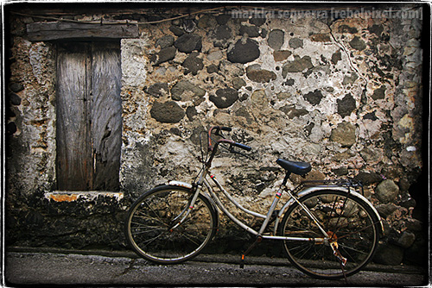
The Perceptual System
Visual Processing
Perception of size
Familiarity
Depth perception
Color perception
Reading
Notes:
Perception – Ability to hear or become aware of something through the senses

Slide 8
The Perceptual System
Visual Processing - Reading
Perception and processing of text is a special case
Stages:
Visual pattern of the word is perceived
Decoded with an internal representation of the language
Syntactic and semantic analysis
Example: Reading “IL”

Slide 9
The Perceptual System
Visual Processing - Reading
Adults read 250 words per minute
Words are recognized by shape
Removing word shape clues by using all caps is detrimental to reading speed and accuracy

Slide 10
The Perceptual System
Hearing
Human beings can hear sounds from 20 Hz to 15 kHz
Can distinguish frequency changes of less than 1.5 Hz at low frequencies
Less accurate at high frequencies
Can be selective
Can convey a lot of information
Not maximized in interface design

Slide 11
The Perceptual System
Touch
Haptic perception - important means of feedback
If and object is seen but not felt, speed and accuracy of a response is reduced
Complaint of VR users

Slide 12
Human Memory
Second part of the model of the human as an information processor
Three types:
sensory buffers
short-term memory
long-term memory

Slide 13
Human Memory
S
E
N
S
O
R
Y
R
E
G
I
S
T
E
R
S
EXECUTIVE CONTROL PROCESSES
Short-term
store (0.5 to
2.0 seconds)
Short-term
memory
(20 seconds)
Long-term
memory
Data lost from the system

Slide 14
Human Memory
Sensory Memory
Iconic (visual) - persistence of the image after the stimulus has been removed
Echoic (aural) - allows a brief “playback”
Haptic - touch

Slide 15
Human Memory
Short-Term Memory
Scratch-pad for temporary recall
Used for information needed fleetingly
Rapid access, limited capacity
7 +/- 2 chunks of information
Patterns are useful memory aids

Slide 16
Human Memory
Long-Term Memory
We store everything we “know” - factual information, experiential knowledge, procedural rules of behavior
Huge, if not unlimited
Relatively slow access time (1/10 second)
Forgetting occurs more slowly

Slide 17
Human Memory
Long-Term Memory – Structure
Episodic – memory of events stored sequentially; can reconstruct actual events
Semantic – structure derived from facts, concepts, or skills; derived from episodic memory
Can be organized to:
Semantic networks
Frames
Scripts
Production rules

Slide 18
Human Memory
Long-Term Memory – Structure (Organization)
Semantic networks
Interconnections or associations among memories
Does not allow to model the complex objects or events composed of several activities
Example: what are the words currently associated with “dog”?

Slide 19
Human Memory
Long-Term Memory – Structure (Organization)
Frames
Objects that contain slots or attributes
Attributes represent default, fixed or variable information
Example: dog
Fixed - Legs: 4
Default - Diet: Carnivorous, Sound: Bark
Variable – Size, Color

Slide 20
Human Memory
Long-Term Memory – Structure (Organization)
Scripts
Represents default stereotypical information
Contains: entry conditions, results, props, roles, scenes, and tracks
Example:
Goal: To fill my mug with coffee
Entry conditions: My mug must first be empty
Results: My mug is full of coffee
Props: Mug, coffee machine, coffee
Roles:
Secretary makes the coffee
I fill my cup

Slide 21
Human Memory
Long-Term Memory – Structure (Organization)
Production rules
Series of condition-action (if-then) statements
Examples:
IF it is raining THEN bring an umbrella
IF the high school is being dismissed THEN traffic will be horrible

Slide 22
Human Memory
Long-Term Memory – Processes
Storing
Total time hypothesis - amount learned is proportional to amount of time spent
Distribution of practice effect - learning time is most effective if distributed over time
Information must be meaningful for it to be stored

Slide 23
Human Memory
Long-Term Memory – Processes
Forgetting
Decay
Interference - old replaced by new or vice versa
Retroactive interference – new information replaces the old
Proactive inhibition – the old memory interferes with the new information

Slide 24
Human Memory
Long-Term Memory – Processes
Remembering
Recall - reproduced from memory
Recognition - the info has been seen before

Slide 25
Human Thinking
Reasoning
Process of deriving new information from what is known
Types:
Deductive reasoning – two or more assertions that lead to a conclusion; mathematical certainty
Inductive reasoning - arriving at generalizations from observations we have seen about cases we have not seen
Abductive reasoning - formulation of hypotheses to explain a phenomena

Slide 26
Human Thinking
Problem Solving
Process of finding a solution to an unfamiliar situation
Three examples:
Gestalt
Problem space theory
Analogy in problem solving

Slide 27
Gestalt
People draw on previous experiences
Have insights
People as sense-makers
Restructure the problem
Theory lacked structure and support
Does not explain insight and restructuring
The whole is greater than the some of its parts
People perform based on their understanding general principles of a situation
If we perform on memorized facts, we make stupid mistakes

Slide 28
Problem space theory
Problem is represented in terms of problem states
Heuristics are employed to go from initial to goal state
General problem solver works for well-structured domains
Real-world problems are more complex

Slide 29
Skill acquisition
Ability to remember larger and larger chunks, e.g. chess players
Novices - group problems according to superficial characterisitics
Experts - group according to conceptual similarities

Slide 30
Human Error
Human v. Computer | Concept of Error | Types of Slips | Mistakes | Failure to Detect Errors

Slide 31
Human v. Computer
Human
Computer
Result of millions of years of evolution
Guiding principle was survival, not precision
Robustness in the face of unexpected circumstances
Ability to deceive
Less than 100 years old
Reliable
Consistent
Based on mathematics

Slide 32
Human v. Computer
Human (Computation)
Computer (Computation)
Slow, complex
Highly parallel
Rapid change
Error tolerant
Forgiving
Fast
Not fault tolerant
High speed
Precise

Slide 33
The Concept of Error
The computer was given information it could not process
Blame shifted on the human being
Achieving a goal should be a cooperative endeavor
Task is not to assess blame but to complete the task
Types of Errors:
Slip – results from automatic behavior
Mistake – stems from conscious deliberation

Slide 34
Types of Slips
Capture errors
Description errors
Data driven errors
Association activation errors
Loss of activation errors
Mode errors

Slide 35
Types of Slips
Capture Error
A frequently done activity captures the one intended
Example: mistakenly dialing telephone numbers with the same prefix
426-6001 - Ateneo trunk line
426-6071 - DISCS direct line

Slide 36

Types of Slips
Description Error
An action is performed on the wrong artifact
Example:
Bottles of shampoo and conditioner, especially if they have the same bottle design

Slide 37
Types of Slips
Data-Driven Error
Triggered by the arrival of sensory data
Examples:
Typing what you are thinking / hearing / seeing and not what is intended
Calling someone by the wrong name

Slide 38
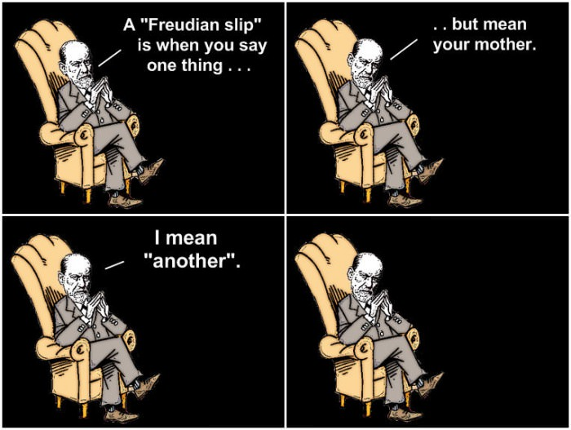
Types of Slips
Freudian Slips
Verbal / memory mistake that usually reveals the subconscious
Example:
A child calling their teacher “Mom” or “Dad”

Slide 39
Types of Slips
Loss of Activation Errors
Act of forgetting to do something
Example:
Walking somewhere to get something but forgetting the moment you step into the destination

Slide 40
Types of Slips
Mode Error
Action sequence performed in the wrong mode
Examples:
Typing in the password with CAPS LOCK on
Using different tools as if it were another

Slide 41
The Concept of Error
Mistake
Choice of inappropriate goals
Poor decision, misclassifies a situation, or fails to take all factors into account
Mental thought is not neat and orderly
The disorder leads to creativity, discovery, and great robustness of behavior

Slide 42
Failure to Detect Problems
User’s ability to detect errors is unreliable
Relevance bias - people seek confirmatory evidence when evaluating a hypothesis
Partial explanation - crude agreement between what the user expects and what he sees
Overlap of model and world - mental model is partially consistent with the world

Slide 43
Designing for Emotions
Why Emotions | Levels of Emotion-Based Processing

Slide 44
Why Emotions?
Emotions makes the human smart
Much of human behavior is subconscious
Affective system helps make judgments
People without emotions cannot choose between alternatives

Slide 45
Effects of Using Emotions for Design
Broadening of thorough processes
Greater creativity
Greater imagination
More tolerant of minor difficulties

Slide 46
Levels of Emotion-Based Processing
Visceral
Behavioral
Reflective

Slide 47
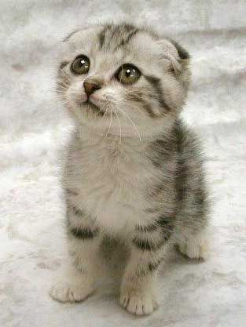
Levels of Emotion-Based Processing
Visceral
Pre-conscious, pre-thought
Appearance matters
First impressions are formed
Initial impact of the product (touch, feel, appearance)
Notes:
What we are essentially referring to here is 'branding'—namely, the act of distinguishing one product from another, not by the tangible benefits it offers the user but by tapping into the users’ attitudes, beliefs, feelings, and how they want to feel, so as to elicit such emotional responses.
This might be achieved by using pictures of children, animals or cartoon characters to give something the appearance of youthfulness, or by using colors (e.g., red for 'sexy' and black for 'powerful'), shapes (e.g., hard-lined shapes) or even styles (e.g., Art Deco) that are evocative of certain eras.
Visceral design aims to get inside the user's/customer's/observer's head and tug at his/her emotions either to improve the user experience (e.g., improving the general visual appeal) or to serve some business interest (e.g., emotionally blackmailing the customer/user/observer to make a purchase, to suit the company's/business's/product owner's objectives).

Slide 48
Levels of Emotion-Based Processing
Behavioral
Focuses on the use
Experience with the product:
Function
Performance
Usability

Slide 49
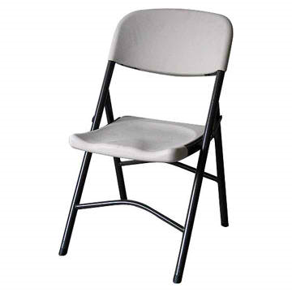
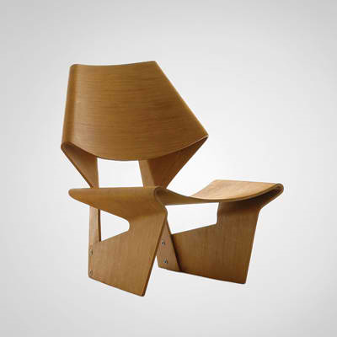
Levels of Emotion-Based Processing
Behavioral
Notes:
Behavioral design (we shall use this term in place of usability from now on) is interested in,
for example, how users carry out their activities,
how quickly and accurately they can achieve their aims and objectives,
how many errors the users make when carrying out certain tasks,
and how well the product accommodates both skilled and inexperienced users.

Slide 50
Levels of Emotion-Based Processing
Reflective
Affected by culture, experience, education, and individual differences
Can override the visceral and behavioral
Sophistication vs. popularity
Long-term relationships
Consideration of the future
Notes:
This is the highest level of emotional design;
representing the conscious thought layer, where we consciously approach a design;

Slide 51
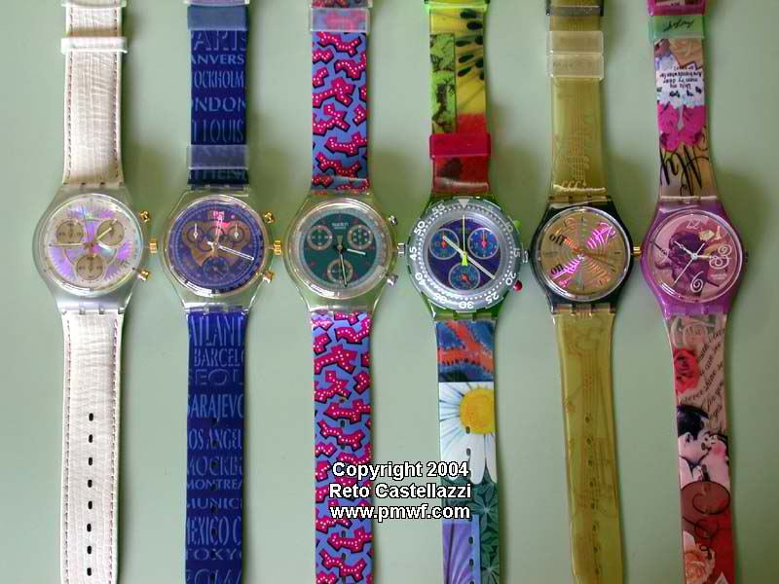
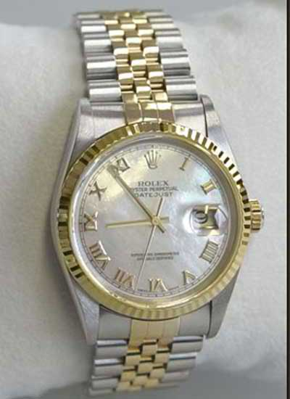
Levels of Emotion-Based Processing
Notes:
What will my friends think when they see me wearing this watch?

Slide 52
Levels of Emotion-Based Processing
Working with the three levels:
Visceral - appearance
Behavioral - pleasure and effectiveness of use
Reflective - self-image, personal satisfaction, memories

